Slide 1

Artificial Intelligence for Predicting Responses to Thyroid Cancer Treatment
Alaa Ali Abd-Alrazaq

Slide 2

Outlines
1
2
4
Introduction
Methods
3
Results
Implications and limiations

Slide 3
Thyroid gland
Small, butterfly-shaped gland.
located in the front of the neck, just below the Adam's apple.
Produces thyroid hormones.
Essential for regulating metabolism, energy production, and body temperature

Slide 4
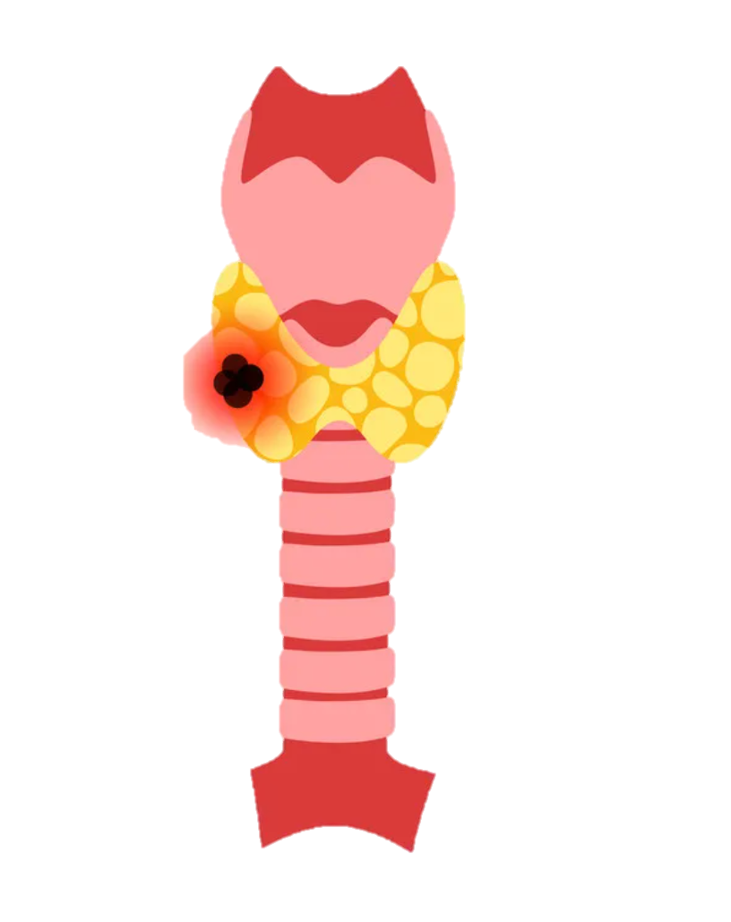
Thyroid Cancer
One of the most common endocrine malignancies.
Abnormal growth and division of cells in the thyroid.
Over 586,202 new cases of thyroid cancer emerged in 2020.

Slide 5

Thyroid cancer treatment
Surgical intervention
Radioactive iodine therapy
Thyroid hormone therapy
Chemotherapy

Slide 6

Response to thyroid cancer treatment
Response to thyroid cancer treatment can be:
Excellent
Indeterminate
Biochemical incomplete
Structural incomplete
Because thyroid cancer varies in type, stage, and how it affects each person, treatment responses can differ significantly

Slide 7
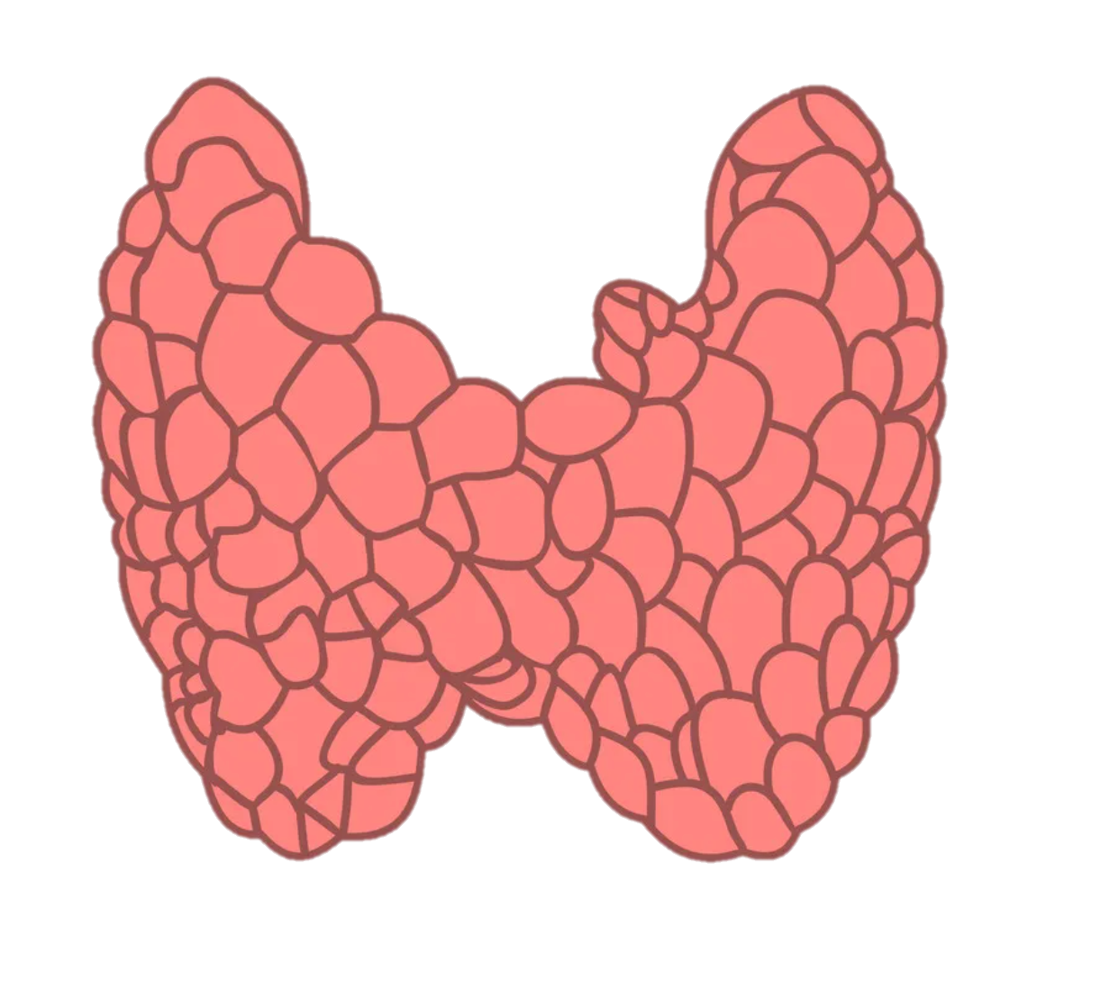
Predicting treatment response
Accurately predicting a patient's responses to thyroid cancer treatment is important to
Optimize
Mitigate
Enhance the chances of successful outcomes
Minimize potential side effects and complications
Customize
Allocate
Tailor personalized treatment plan
Improve healthcare resource allocation

Slide 8
Research Problem
01
02
03
Predictive Potential of AI in Treatment Response
Harnessing AI to forecast and enhance treatment outcomes.
Limited Exploration: Assessing AI in Treatment Response
An examination of the scarcity of studies exploring AI's effectiveness in predicting treatment responses.
Critical Examination: Limitations in Existing Studies
Evaluating constraints and drawbacks in the current body of research on AI's role in treatment response prediction.

Slide 9
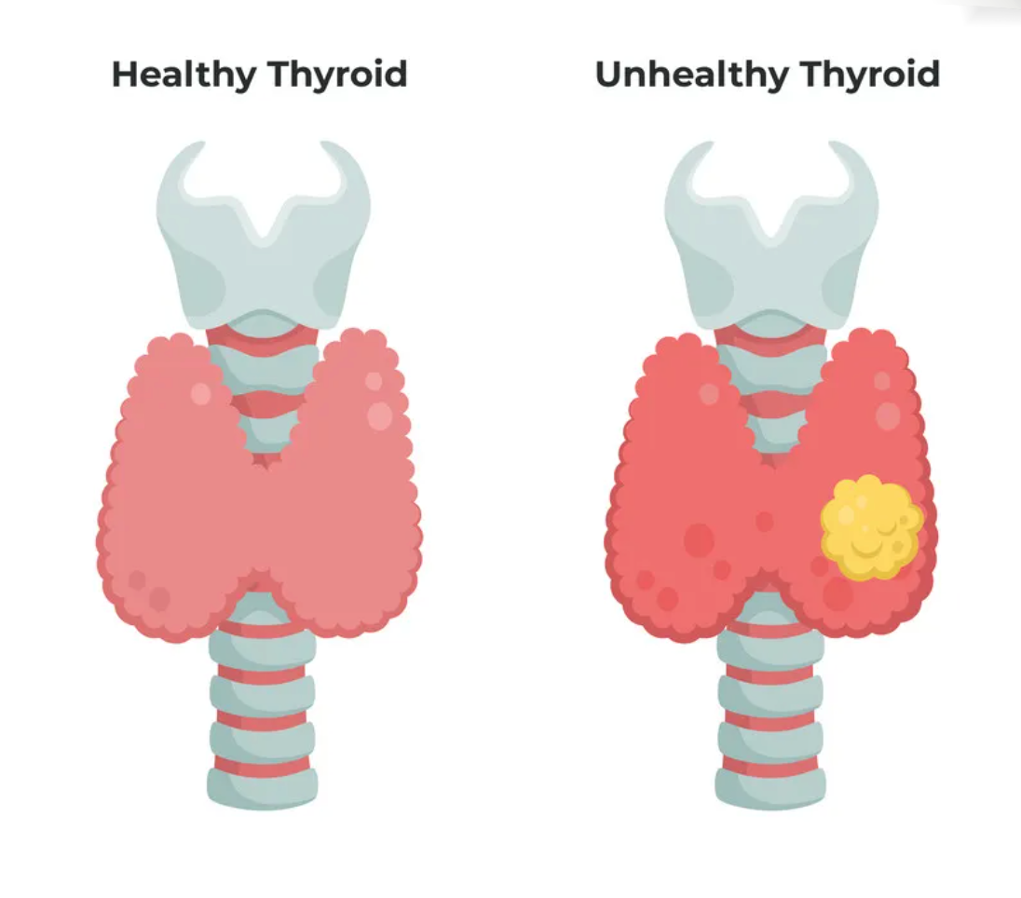
Project Aim and Objectives
AIM
To develop and evaluate AI models that can accurately predict the initial treatment response among patients with well-differentiated thyroid cancer.
Objectives
To find a public dataset related to this topic.
To perform pre-processing for the dataset.
To train various AI models using different sets of features.
To evaluate the performance of these models.
To formulate recommendations.

Slide 10
Data Acquisition and Uploading
Features
Open Sourced
17 variables
16 variables used in this study:
15 as features
1 as a target variable (treatment response)
posted by Shiva Borzooei on UC Irvine Machine Learning Repository.
Dataset
Size
Variables
DATA
Number of Participants
The total Number of participants are 383 patients

Slide 11
Data Preparation Workflow
Data Pre-processing
Handling missing values
Checking data distribution
Final Predictions
Exploratory Data Analysis (EDA)
Data visualization
Correlation heatmap
Data Transformation
Data Coding

Slide 12
Experiment Overview
Variety of Experiments
Sampling Strategies
Nine experiments conducted exploring different scenarios
Employed 3 sampling strategies
AI Model Diversity
Data Split Approach
Utilized 7 different AI models
Utilized a training-test split approach
Feature Set Exploration
Performance Metrics
Investigated insights with 3 sets of features
Evaluated results using 5 performance metrics
Target Variable Analysis
Worked with both binary and multi-class targets

Slide 13
Results
Models in all experiments achieved an average accuracy of 72.2%, average precision of 76.2%, average recall of 68%, average F1 score of 70.6%, and average AUC of 80.5%.
AI models exhibited superior performance in predicting a binary treatment response compared to predicting multi-class treatment responses in terms of accuracy (76.8% vs.67.6%), precision (87.3% vs. 65.1%), recall (68.3% vs. 67.6%), F1 score (76.1% vs. 65%), and AUC (84.3% vs. 76.8%).
Multi-layer Perceptron achieved the highest accuracy (81.8%), recall (75%), and F1 score (81.7%) in this study when it was used for predicting binary treatment response using all features, excluding those weakly correlated with the treatment response.
Naive Bayes attained the highest precision (95.1%) and AUC (88.7%) in this study when it was used for predicting binary treatment response using all features.

Slide 14
Practical and research implications
Healthcare providers should not solely rely on our models.
Future research should enhance predictive capabilities by including additional features, exploring alternative models, and utilizing larger and balanced datasets.
Validation techniques like k-fold and leave-one-out cross-validation are crucial, especially with small datasets.
Researchers should assess the performance of AI models in predicting responses to various types of thyroid cancer treatments.
Prioritizing the prediction of multi-class treatment responses is also essential

Slide 15
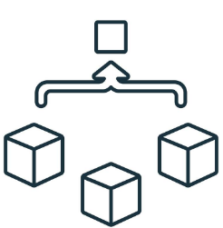
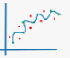



Limitations
Limited generalizability
Potential overfitting
Other validation methods
No advanced DL models
No insights for predicting the response of specific treatments

Slide 16
THANKS!
Does anyone have any questions?
aaa4027@qatar-med.cornell.edu

